Slide 1
CAS Applied Data Science
Module 4
Best Practices for Data Science and
Scientific Computing
2023-10-20

Slide 2
Objective / research / business case formulation
Use research from well known credible sources.
Define clear and measurable, objectives.
Think through the purpose of the project
Think of possible pitfalls of the project
Think easy not complicated.
Notes:
737

Slide 3
Write Programs for People, Not Computers
a program should not require its readers to hold more than a handful of facts in memory at once (1a).
Programs are for people not computers.
Write coherent easy to understand code - not 100… of line of code.
Think scientifically.
make names consistent, distinctive, and meaningful (1b)
Keep naming conventions.
Stay consistent.
Use meaningful variable names.
make code style and formatting consistent (1c)
Stick to a programming single format - Classes, Functions, OOP.
Indentation.
Program comments.
Notes:
737

Slide 4
Group 2
- Rigorous Mathematical Analysis before Data Analysis e.g. – look for p-value
- Specialized Engineers should be hired to better understand the scope of the project data.
Notes:
737

Slide 5
Group 2
Notes:
737

Slide 6
Ethics and BP in Data Cleaning and Preprocessing
Transparency and documentation
Bias and fairness
E.g., racial, gender, socio-economic-status …
Also cherry-picking
Handle missing Data
Can be biased
Privacy
Anonymization
Communication
If data is biased / low quality, don’t overemphasize results
Feedback-loop with collaborators
Notes:
737

Slide 7
Make incremental changes
Work in small steps with frequent feedback and course correction
real world changes frequently
working code after each iteration, iteration cycles 1 week
Use a version control system
like Git & GitHub
compare and work on different versions
Put everything that has been created manually in version control
include everything in VCS, code, metadata etc.
except (large) original Data, Pictures etc. → Archives
Notes:
737

Slide 8
Group 4 - Feature Engineering
reproducible, understandable → Transparency
→ able to understand what exactly has been done
explain why you do each step
→ able to understand reasoning
Examples
dataflow diagram of code
normalisation of variables → explain why
Notes:
737

Slide 9
Group 4 - Don’t repeat yourself
Create programs for steps that repeatedly are used (loading data e.g.)
Reuse instead of rewrite → saves time
every piece of data must have a single authoritative representation in the system?????

Slide 10
Group 5: Plan for mistakes.
Mistakes are inevitable - don’t panic!
(a) Add assertions to programs to check their operation.
checkpoints with python command “assert”: stops if result is not as expected
works also as a form of documentation
(b) Use an off-the-shelf unit testing library.
“Automated testing”: unit tests / integration tests / regression tests
(c) Turn bugs into test cases.
Anticipate possible errors, program accordingly
Try to provoke errors to see if they still occur
(d) Use a symbolic debugger.
is a line-by-line “interactive program inspector”
lets the programmer witness live what is happening in the code, e.g with the variables
Notes:
737

Slide 11
Group 5
Notes:
737

Slide 12
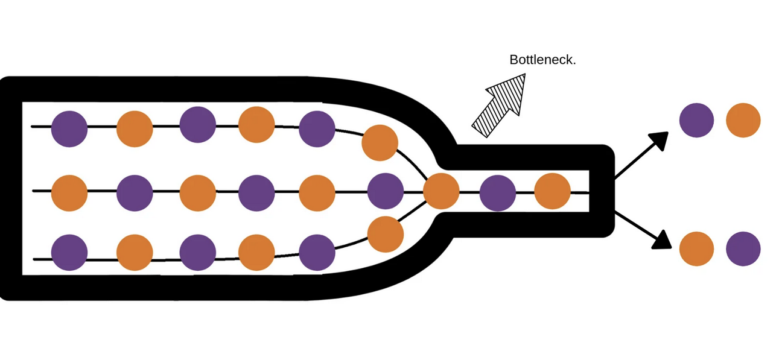
Group 6 : Optimize software only after it works correctly.
Goal : Improve the efficiency of a given code
Run a functional code
Determine the needs to optimise it more
Use a profiler to identify bottlenecks
Program analysis determining which lines in the code are taking more time and/or CPU ?
Notes:
737

Slide 13
Group 6 : Optimize software only after it works correctly.
2 categories of coding languages:
highest-level language (e.g. Python) : slower but more intuitive
lowest-level languages (e.g. C++) : faster but more difficult to write
Recommendations
(b) Write code in the highest-level language possible.
Switch to a lowest-level language when the program performances require it
Notes:
737

Slide 14
Group 7
Notes:
737

Slide 15
Group 7 - Presentation and publication
Why?
A good documentation makes the code reusable and lowers maintenance costs. Furthermore it allows a smooth handover.
How?
It is not about inline documentation.
Document interfaces and reasons, not implementations (explain inputs and outputs).
If a substantial description of the implementation of a piece of software is needed, refactor code in preference to explaining how it works (if possible).
Embed the documentation for a piece of software in that software and update it.
-> Document generator examples: “Javadoc, Doxygen, or Sphinx”
-> Alternative: “literate programming”, for example “knitr” or “IPython Notebooks”
Notes:
737

Slide 16
Group 8
Notes:
737

Slide 17
Group 8
Notes:
737

